Slide 1

PARIS
Apexa investment Product recommendation service

Slide 2
Agenda
What is a neural network
How do we build recommendation system
Proposition
PARIS
Business impact (short & long term)
Q&A

Slide 3
What is a neural network

Slide 4
It is a method of finding the relationship between a collection of inputs and its corresponding outputs

Slide 5




It is made up of 1 or more layer
Each layer is made up of 1 or more neuron (perceptron)

Slide 6


Neuron (perceptron)
It is the most basic unit in a neural network
The weights [W0 - Wn] is the relationship that we are looking for

Slide 7
Step Function aka Activation function
A function to limit the output’s data range
Add non-linearity into a neural network

Slide 8
We train the neural network to workout 1 set of weights that work across the entire dataset (seen or unseen) and we are using the weight for predictions

Slide 9
How do we build Recommendation system (From PAST to Present)

Slide 10
Matrix Factorisation
(MF)
A Variant OF Collaborative filtering (CF)

Slide 11
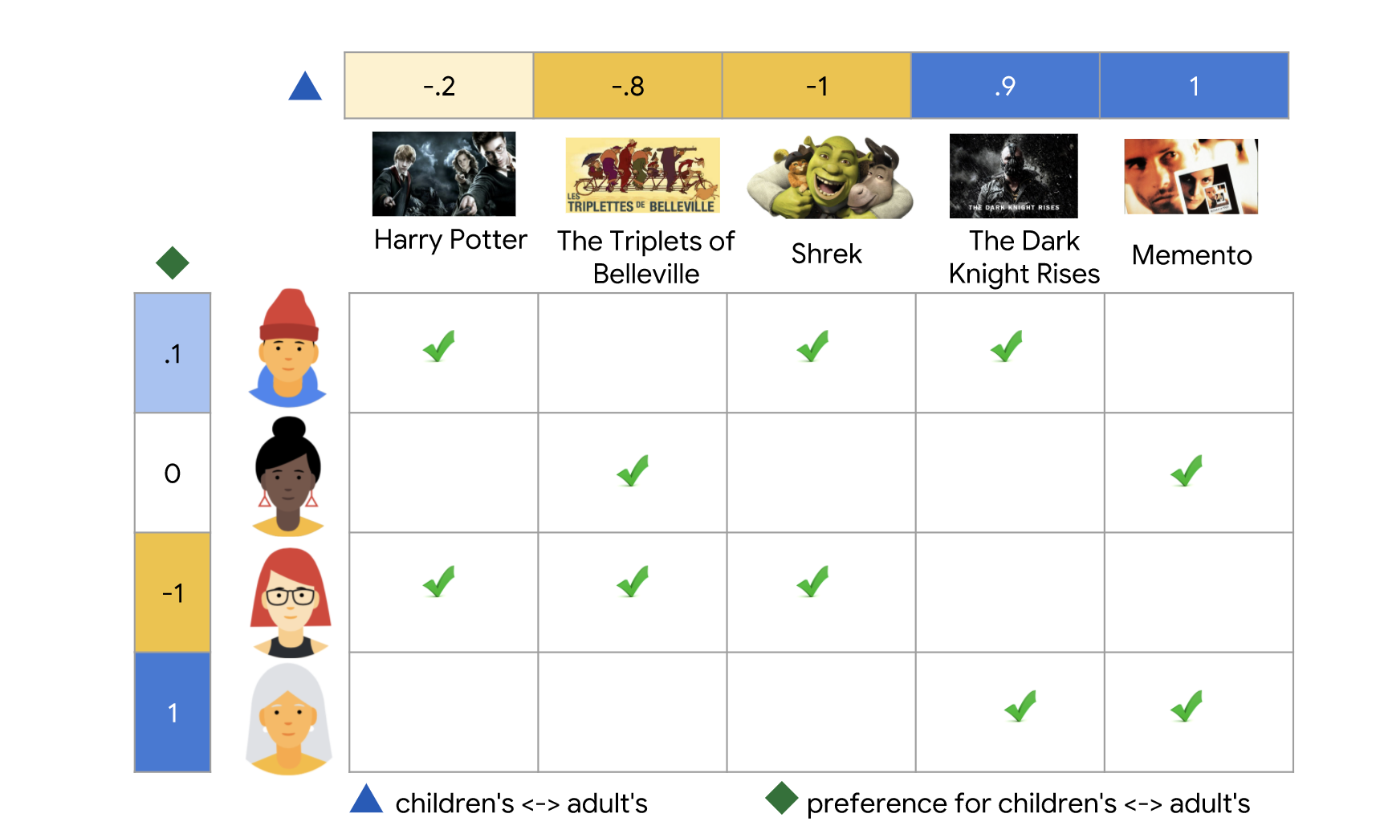

What is a matrix factorization (MF)
A dot product of 2 matrix to approximate the level of interest between the customers and the products
Describes whether the movie is for children (negative values) or adults (positive values).
Describes the user's interest in children's movies (closer to -1) or adult movies (closer to +1).
Each tick means user have watched the movies

Slide 12
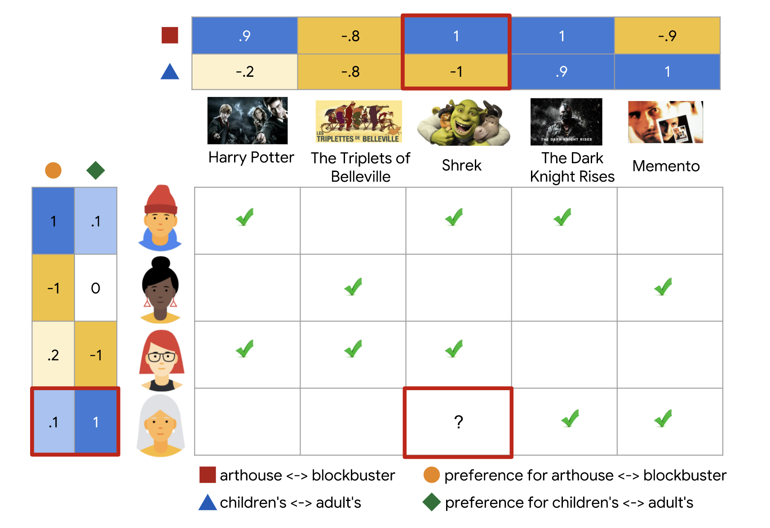
Describes whether the movie is Arthouse (negative values) or Blockbuster (positive values)
Describes the user's interest in Arthouse (closer to -1) or Blockbuster (closer to +1)
We can use dot product between 2 matrix to find the missing values

Slide 13

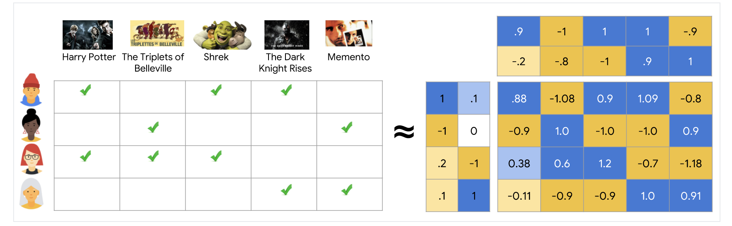

Dot Product of [0.1, 1] and [1, -1] give us -0.9

Slide 14
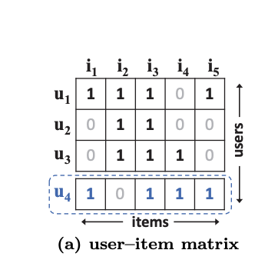
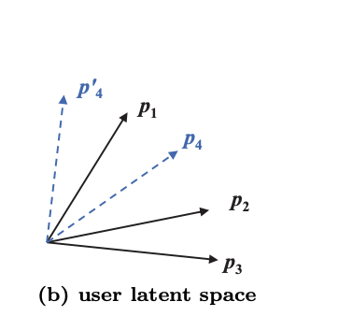
Limitation
We can see very clearly that row U4 is similar to row U1, U3 and then row U2
We can see that after transformation, P4 is similar to P1, P2 then P3 which contradict to the 1st conclusion, incurring a large ranking loss
Transform
However if we transform each row to another plane, we see a different result

Slide 15
Use of Neural network in collaborative filtering
(NCF)

Slide 16
Neural Matrix Factorisation
(Neumf) A variant of NCF

Slide 17


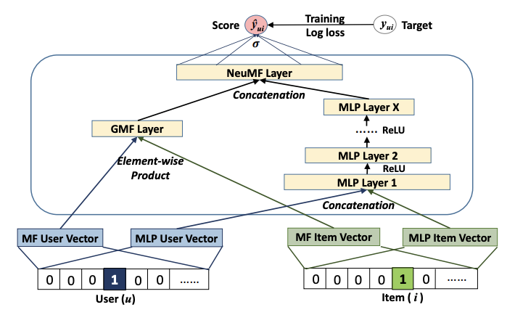


5
Combine the Output
4
3
Multi-Layer Perceptron
A Matrix Factorisation
1
Each user(u) represent a user’s data (age, occupation, country of origin etc)
Each Item (i) represent a product’s data (name, risk, x years of return etc)
2

Slide 18
Why NCF?

Slide 19




Wide-and-deep, developed by GOOGLE and launched on PlayStore (2006)
NCF
Minimal runtime with outstanding accuracy

Slide 20
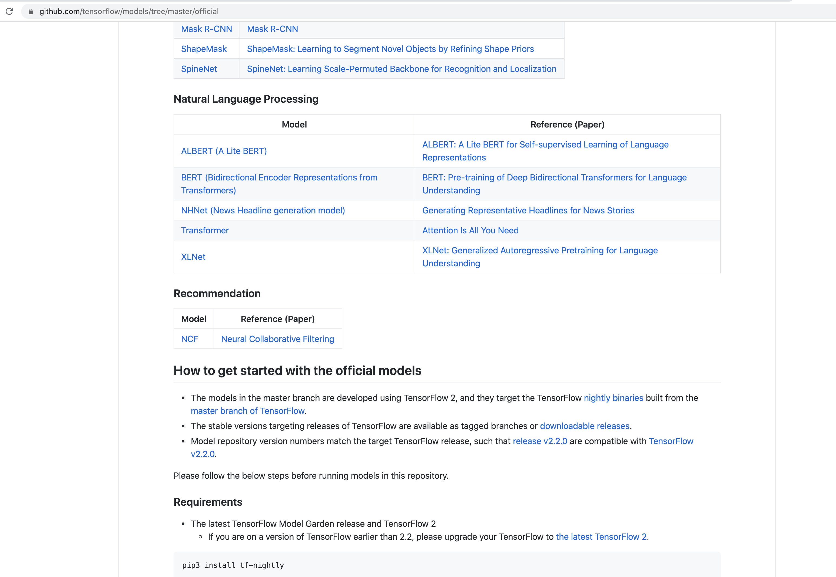

On the Official TensorFlow
NCF is the only recommended model for Recommendation system

Slide 21
Proposition

Slide 22
PARIS aim to compare different portfolios and predict whether a customer should be interested in certain products or not

Slide 23
PARIS

Slide 24

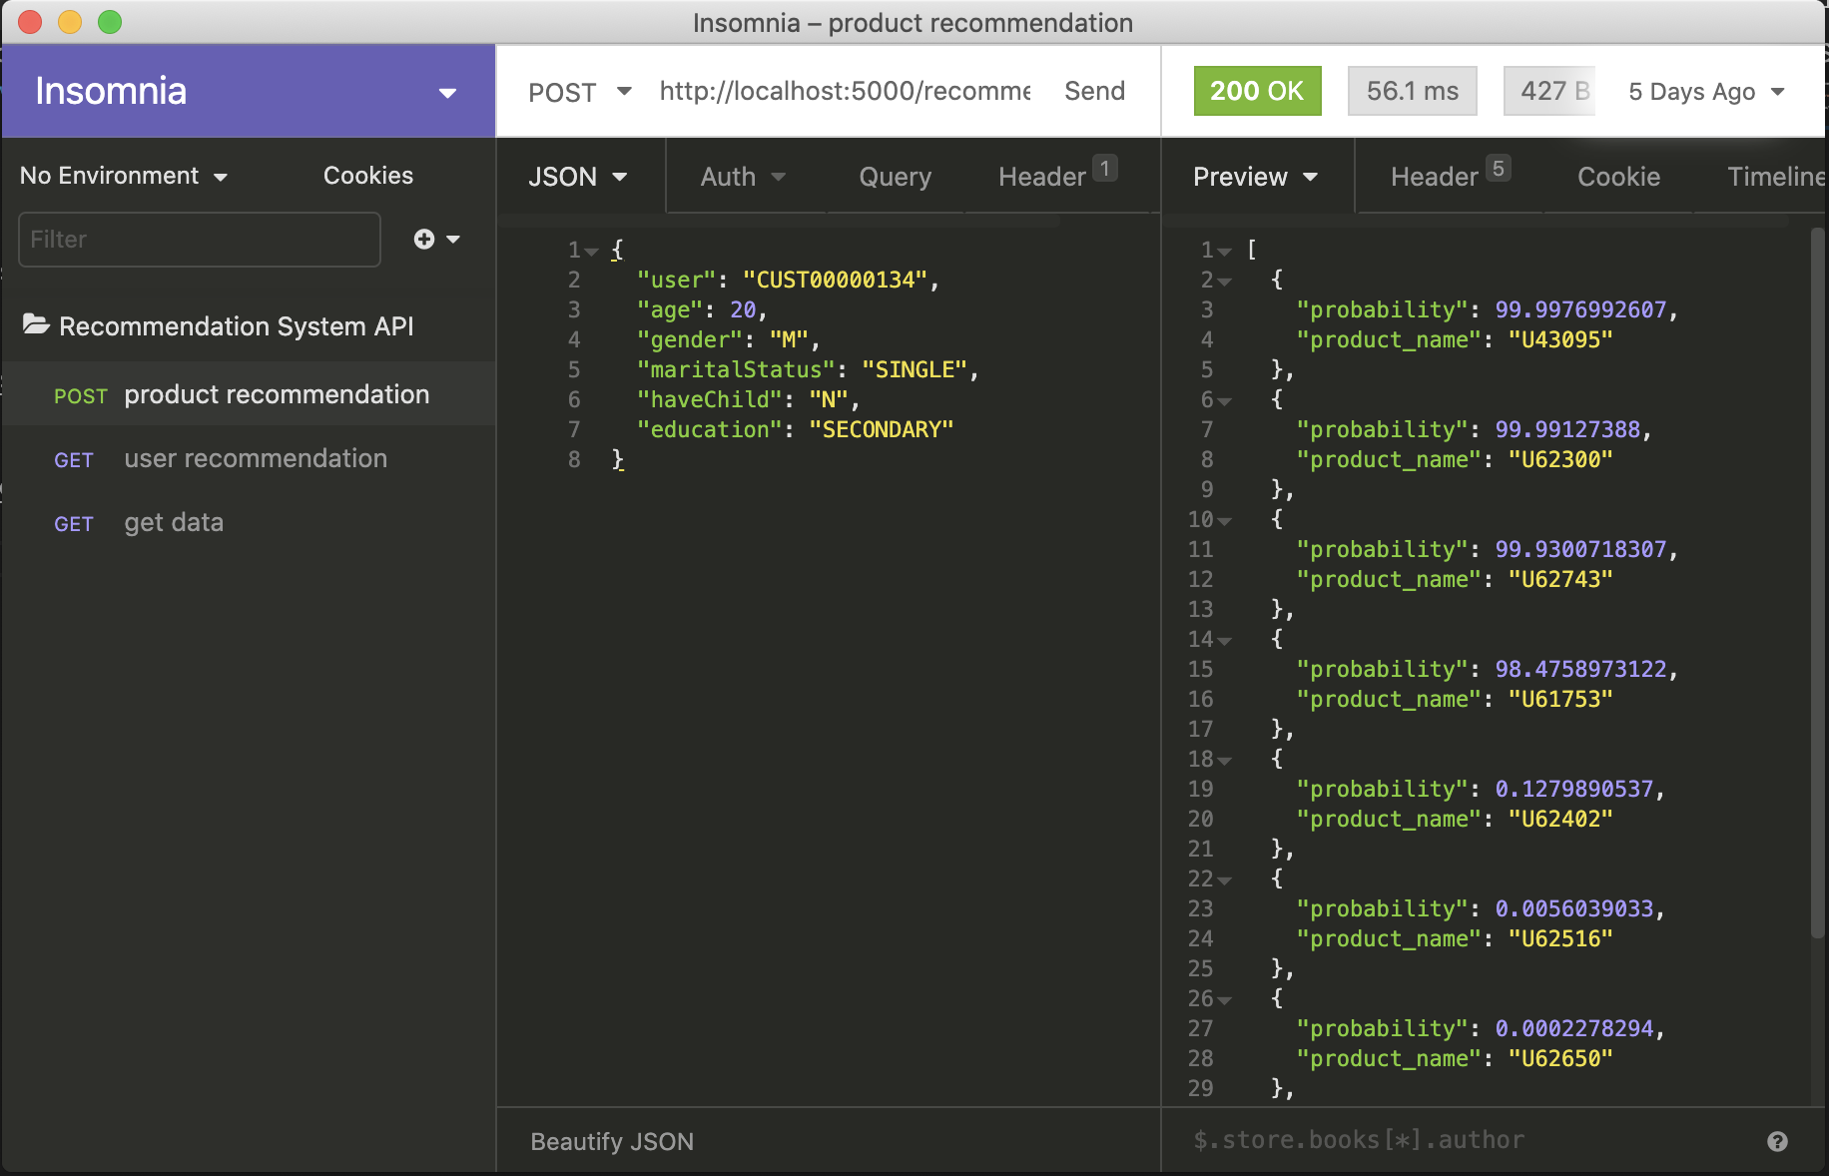
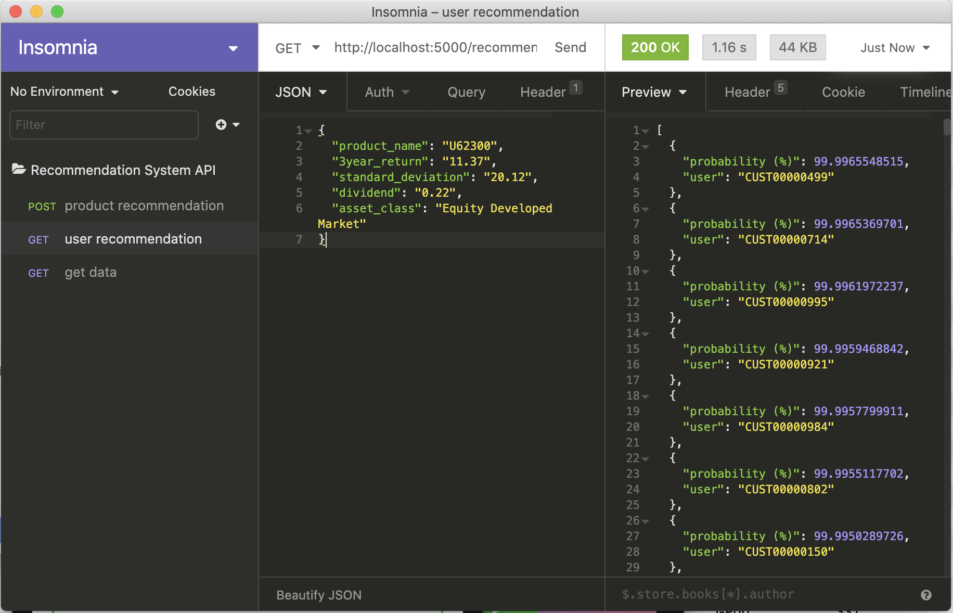




https://github.com/OneDodge/financial-product-recommendation-system/
1
2
Given a New / Existing user, we are able to compute a list of products that he/she is interested in
Given a New / Existing product, we are able to compute a list of customers that they are interested in

Slide 25
Business IMPAct (Short Term)

Slide 26
PARIS ON Easy-Invest

Slide 27
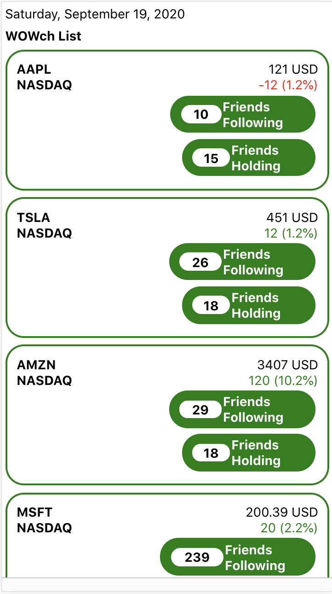
https://github.com/OneDodge/financial-product-recommendation-system-ui-react-native
1
A Facebook / IG liked (Whats trending area)
2
Add social network features to boost customer stickiness
3
AI Powered bringing a different banking experience

Slide 28
Paris ON RMP

Slide 29
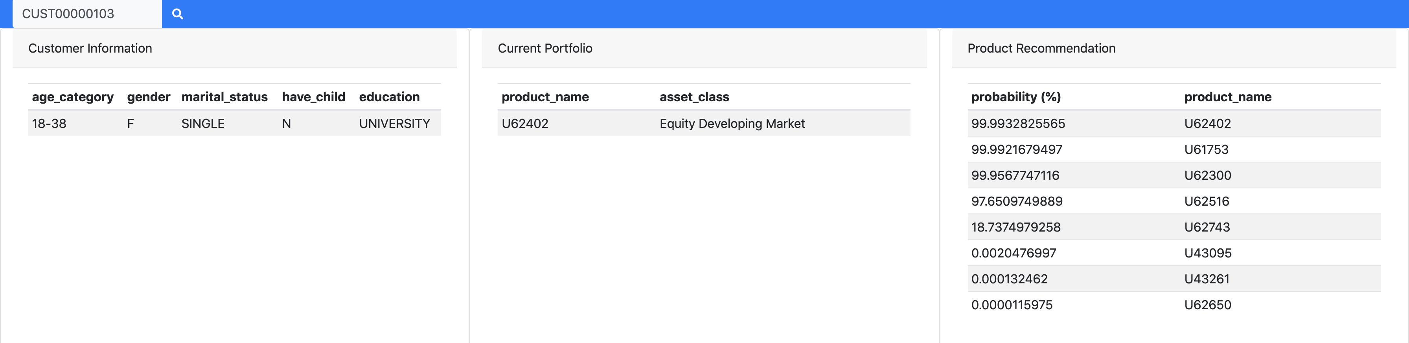
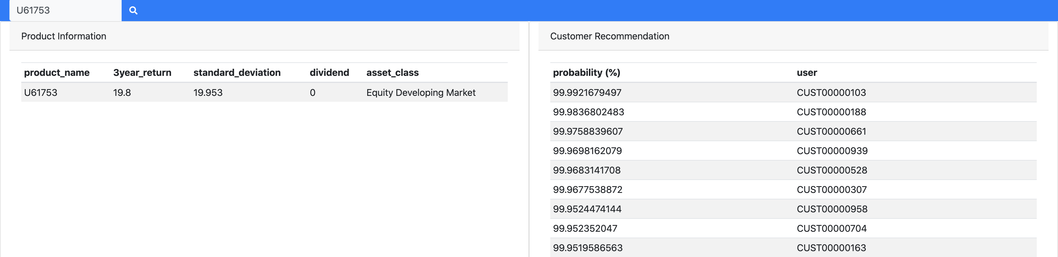
https://github.com/OneDodge/financial-product-recommendation-system-sales-portal
1
If RM is meeting a VIP and being asked what to buy, we can give a suggestion in a click of a button
2
Instead of cold calling customers that might or might not be interested, why not cold call customers what we know have a higher chance of interest to the product

Slide 30
Business Impact (Long Term)

Slide 31
Paris ON property Business

Slide 32
Get Latest Property Data from Property Enterprise
Leverage AI to predict property’s true value
1
2
4
Property Enterprise
AI powered Nxt-Gen Property Valuation System
AI powered Nxt-Gen Loan Approval system
Use PARIS to compute the likelihood of customer interested with certain properties
5
1 Click to get loan approval for the given property selected
PARIS
HSBC e-Banking
3
Push the data to the e-banking news feed

Slide 33
Question

